Slide 1
Readers Cafe
TEAM MEMBERS:
Sharath Babu Srinivas- Team Lead
Karthik Yogendra Bangera
Manjunath Panduranga
Mehal Chaudhari
Pranika Jain
Rishit Reddy Muthyala
Sakshi Varshney

Slide 2
Overview
Reader’s cafe is a one stop platform for bibliophiles where users can browse through a book catalog and select/buy a variety of books based on their interests.Reader’s cafe has a variety of features like:
Different access for admin and users.
Admin : Add, update and delete the book information based on the availability of the book.
Users : Explore books based on their interests , filter the search criterias according to their interests, purchase books
Payment gateway for purchasing copy of books

Slide 3
Technology Stack
Front-end development:
Angular JS,Angular CLI
Bootstrap
HTML5
Back-end development:
Java Spring boot Framework
MySQL,Hibernate
Redis

Slide 4
Readers Cafe - Admin Portal
Users: Admin
Features:
Add details for a new book
View the list of books added
View and edit details for a selected book based on selection in the list
Remove selected book details from the list

Slide 5
Readers Cafe - Bookstore
Users: Signed in users/guest
Features:
View the given collection of books.
Email verification.
Password Encryption
Payment of orders
Order History

Slide 6
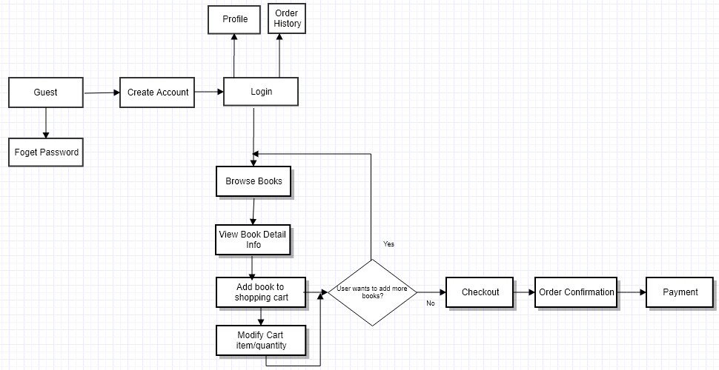

Slide 7
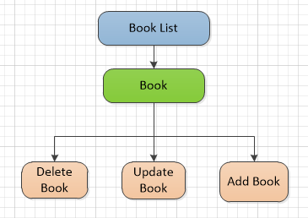
Book Management - Admin Portal

Slide 8
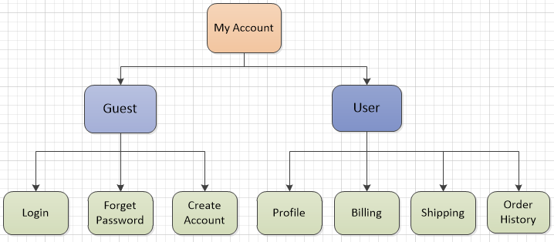
MyAccount Module - Bookstore

Slide 9
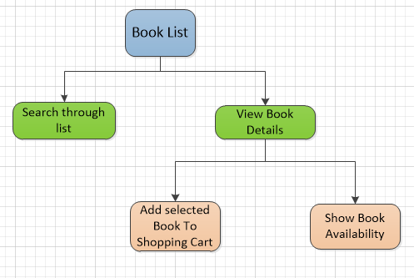
Book List Module - Bookstore

Slide 10
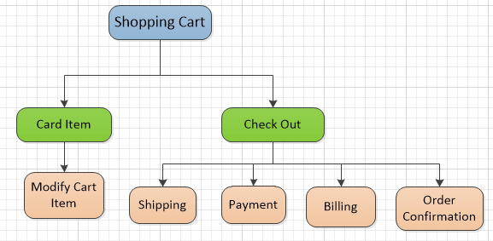
Shopping Cart Module-Bookstore

Slide 11
Additional Features
Chatbot Integration
Reviews

